Slide 1

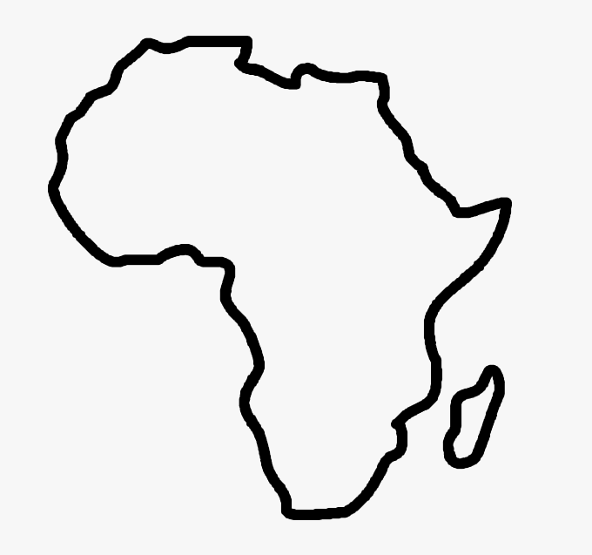


SOCIAL MEDIA REPORT JANUARY – OCTOBER 2025
8 November 2025
FIM Africa General Assembly
Mombasa, Kenya

Slide 2
SOCIAL MEDIA SITE | FOLLOWERS | NEW FOLLOWERS | VIEWS | WATCH TIME
Facebook | 21 161 | 538 | 480K | 3 Days 8 Hours
X | 158 | 99 | NA
LinkedIn | 136 | 38 | 7k
Threads | 314 | 313 | 20k
Instagram | 2107 | 438 | 72K
TikTok | 1360 | 1013 | 34K
You Tube | 286 | 254 | 19,2K | 963.2 Hours
Total : | 25 522 | 2693 | 632 000

Slide 3
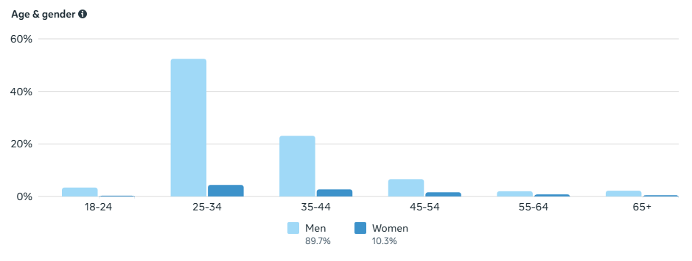
DEMOGRAPHICS - FACEBOOK

Slide 4
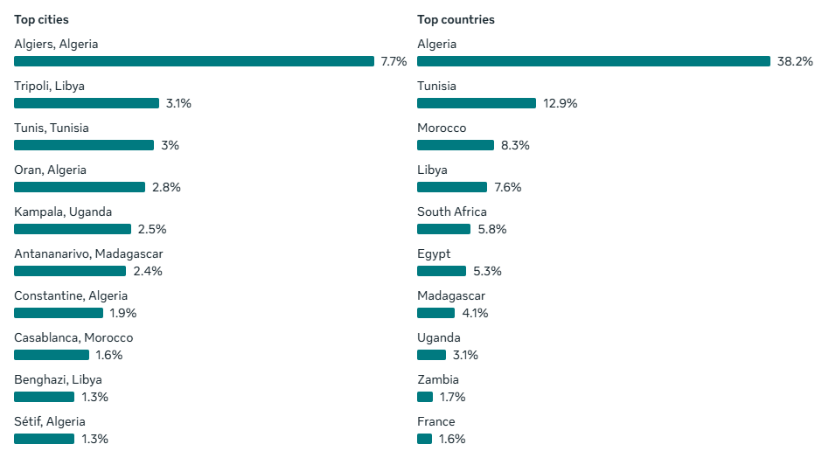
DEMOGRAPHICS - FACEBOOK

Slide 5
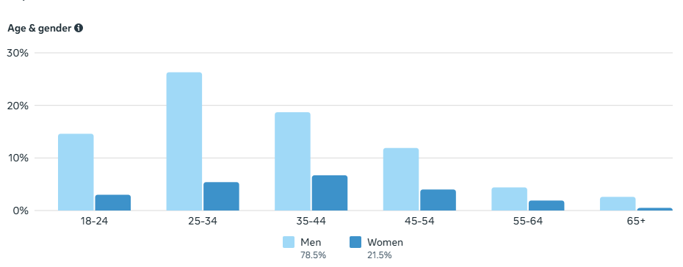
DEMOGRAPHICS - INSTAGRAM

Slide 6
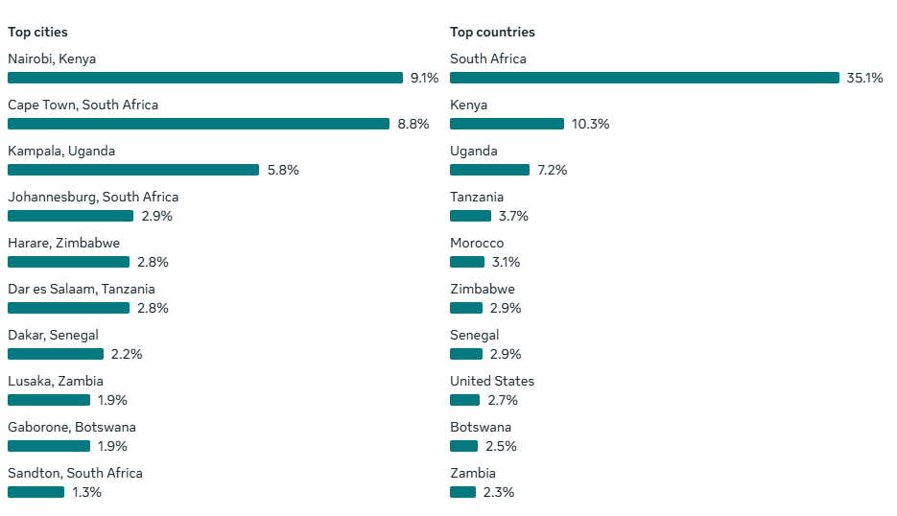
DEMOGRAPHICS - INSTAGRAM

Slide 7
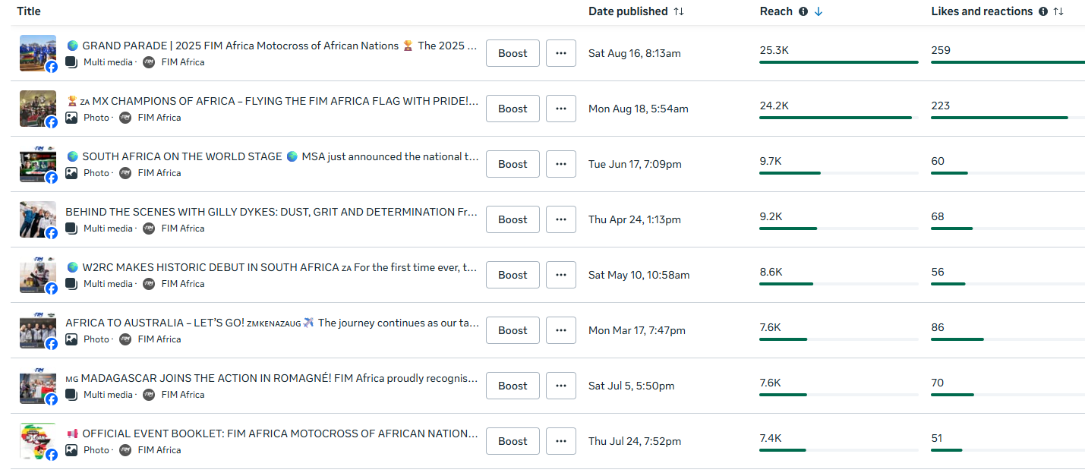
TOP CONTENT

Slide 8
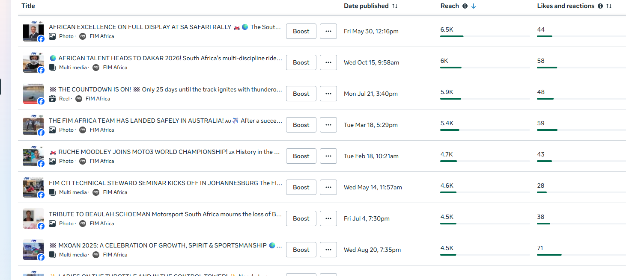
TOP CONTENT CONTINUE

