Slide 1




FIM Africa General Assembly Beyond Sports Report – November 2025
8 November 2025
FIM Africa General Assembly
Mombasa, Kenya

Slide 2
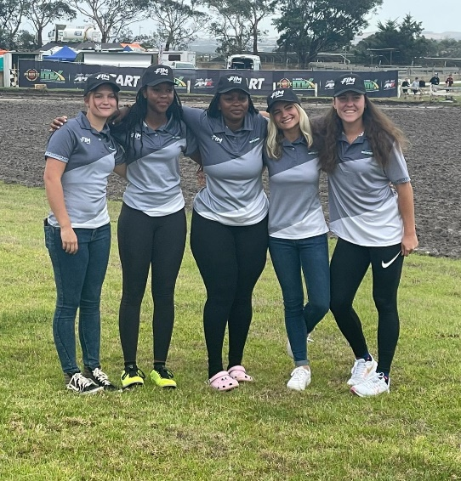
A. WOMEN IN MOTORCYCLING COMMISSION
FIM Oceania Women’s MX Cup
An earlier report was shared regarding the FIM - Africa women’s team participation in the FIM Oceania Women’s cup in March 2025.
In summary however: the team of 5 African athletes representing the following nations:
South Africa - Zoe Botha
Kenya - Atete Benzinge
Uganda - Sharifah Katete
Namibia - Zoe Waldschmidt
Zambia - Leah Heygate

Slide 3
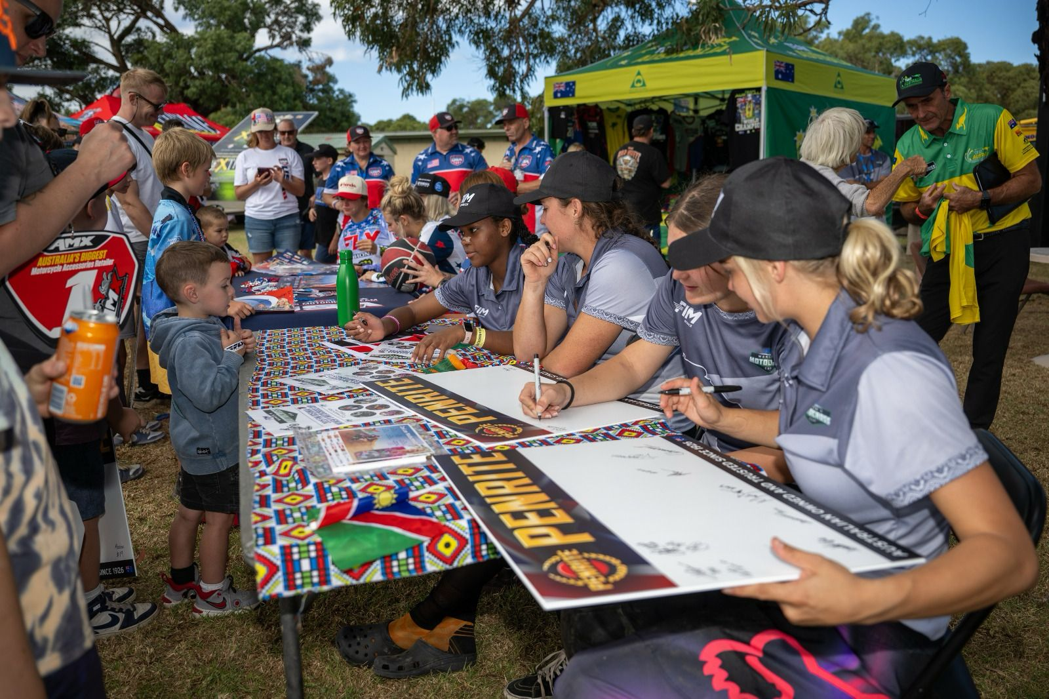
Were the first women’s MX team ever to represent FIM Africa in an international event of this nature. The event held in Wonthaggi from 22nd to 23th of March was a real eyeopener to the team members who rode well with two exceptional performances from Team Captain Leah Heygate and Atete Benzinge, the youngest rider in the competition. The event not only created an opportunity for the riders to test and improve their riding skills at the highest level of international MX but also opened the door to significant networking and learning amongst the international riders participating in the event.
The experience and exposure created a significant buzz on the African continent leading to an increase in awareness and interest in Women’s motocross. Two countries in particular have seen an increase in the participation and retention of female riders particularly in response to this event, in Namibia and Uganda whose performance in the WMX category at this year’s recently completed MX of Africa Nations is testament to this.

Slide 4
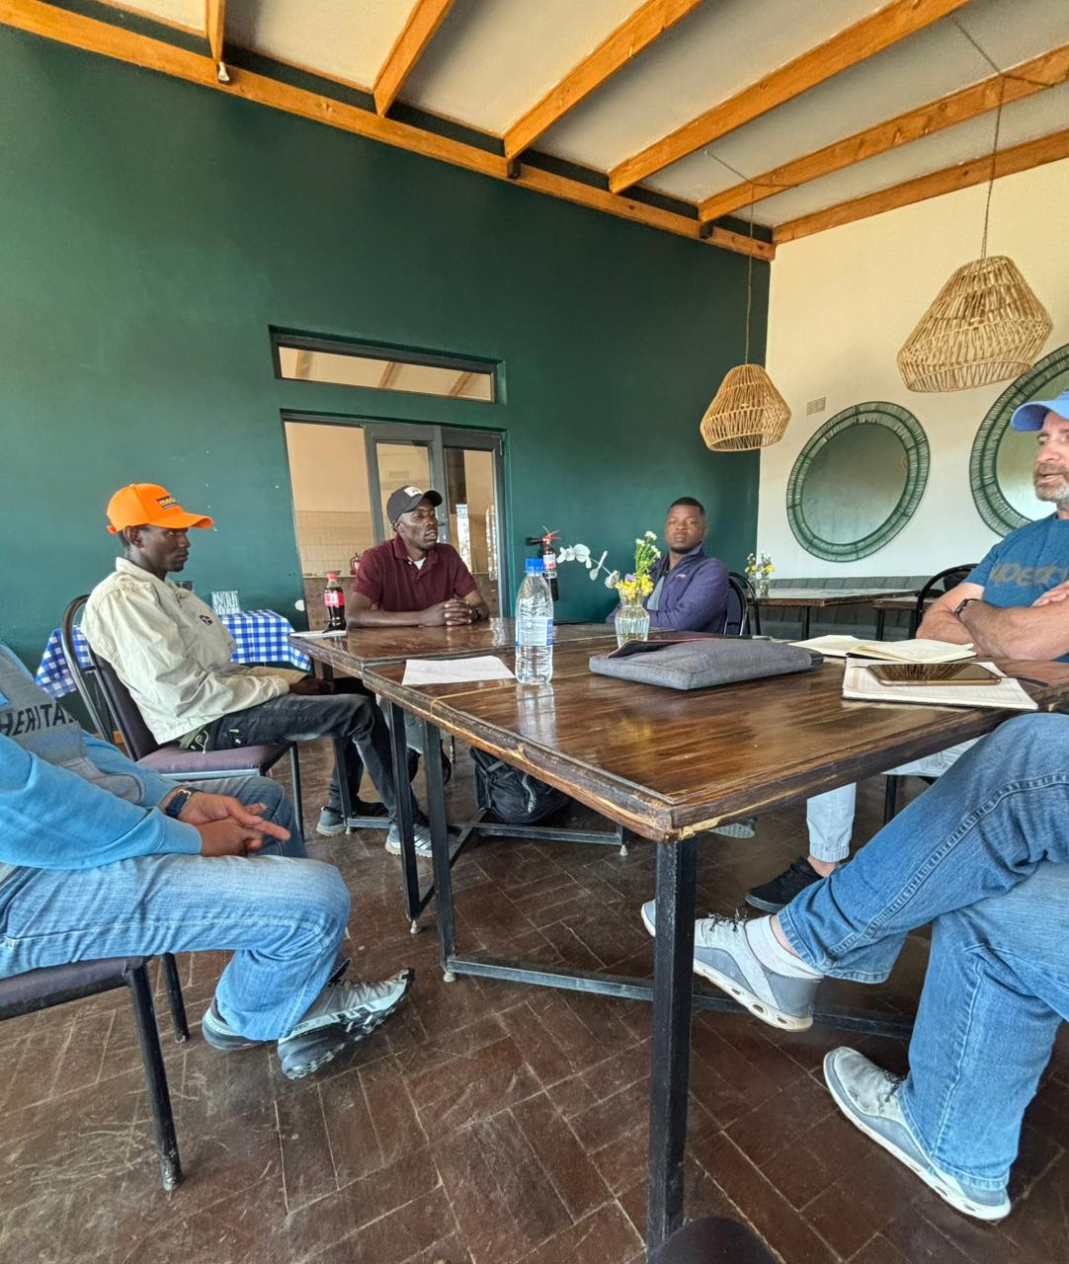
2. Off Road Trainers : Train the Trainer CMRF Programme
After March the focus of the commission turned towards the next phase of Train the Trainer activities under the current FIM CMRF grant. The aim is to conduct two more session in Africa this year. The first of these was held in Zimbabwe at the end of July 2025 details as follows:
Training the Trainer (TTT) Program – Zimbabwe, 30th July – 3rd August 2025
The Stage 3 Train the Trainers programme was successfully conducted in Zimbabwe with the following participants:
K. Mutaramu, B. Rocher, S. Fraser,M. Chidunza, D. Chitopa, Z. Botha

Slide 5
Key Highlights:
The trainees demonstrated strong enthusiasm for acquiring new skills. Although only five trainees attended the classroom sessions, it was a solid representation of Zimbabwe’s future in motorcycling training. Among those present were three of Zimbabwe’s top trainers, who have continued their training activities since the last TTT program in 2019. Their newly gained knowledge will further elevate training structures and enhance riders’ performance. Mr. Rocher and Mr. Fraser, who hold leadership positions at Donnybrook Motorsport Facility, will extend the program’s impact across various disciplines of motorsport in Zimbabwe. Trainer Andre recommended that Ms. Zoe Botha ( one of the participants at the FIM Oceania WMX event) who initially assisted with media became actively involved in the program. Given her wide exposure to races across Africa, she represents an excellent potential ambassador for women in the program. The program successfully covered 16 core aspects of training, complemented with practical sessions. All trainees participated in the three mandatory rider sessions, achieving a positive overall training yield.

Slide 6
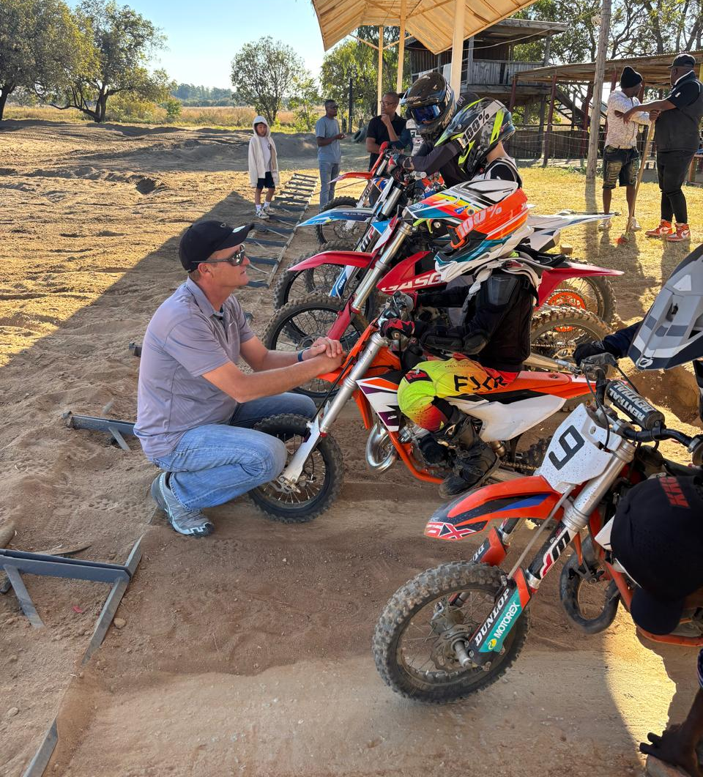
A noted challenge remains limited contact time with young riders during the week due to boarding school schedules, leading to inconsistency in training.
Future Goals
Trainer Andre recommends training local trainers up to Level 2 accreditation and beyond, with a target of 2–3 certified trainers per country. Zimbabwe already has three strong trainers, positioning the country well to support local riders without reliance on external coaches.
The aim of these programmes is to build local training capacity to be able to develop young riders, both male and female, from the grassroots and improve the level and skill of the riders by the time they get to the national and international stage. Each FMN is encouraged to adapt accreditation processes to their federation needs, ensuring that trainers are both competent and officially cleared to safeguard rider development and safety. The next stop for the TTT program will be Senegal (West Africa), with dates to be confirmed soon.

Slide 7
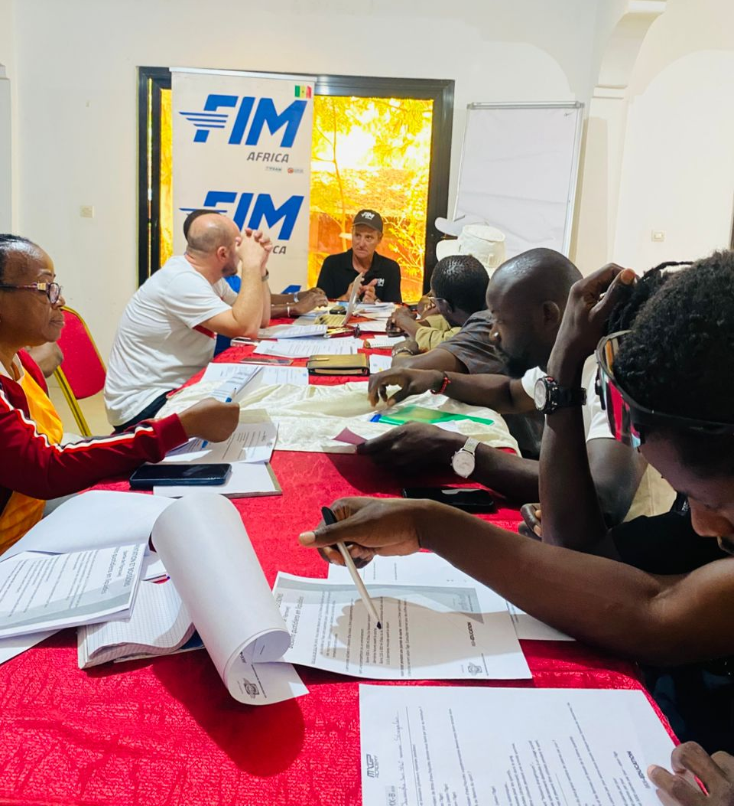
Training the Trainer (TTT) Program – Dakar, Senegal 14th to 22nd October, 2025
Classroom training
The training program conducted in Senegal was an eye opener to the lack of technical information in West Africa. The first classroom theory training saw a mix of students. Ivory Coast had sent their motorsport president along with 3 of their riders. Senegal had 2 of their fastest senior riders present , 6 trainers, a clerk of the course and Daouda Ngom , their hierarchy. The training modules took roughly twice the time to get through because of the translation time. Day 2 and 3 of the training gained traction quickly as we used more visual tools and even a practical training at a nearby track for a few hours.
The trainers
Eleven trainers completed the MX – B test (basics on nutrition, hydration, rider safety protocols and anti doping WADA) and will receive their certificates today. All present in the training were hungry for information. They asked as many questions as needed until they understood the aspect clearly. Despite diverting to other aspects to further understand their circumstances locally this ensured that the training yield, even with the language barrier, was very high.

Slide 8
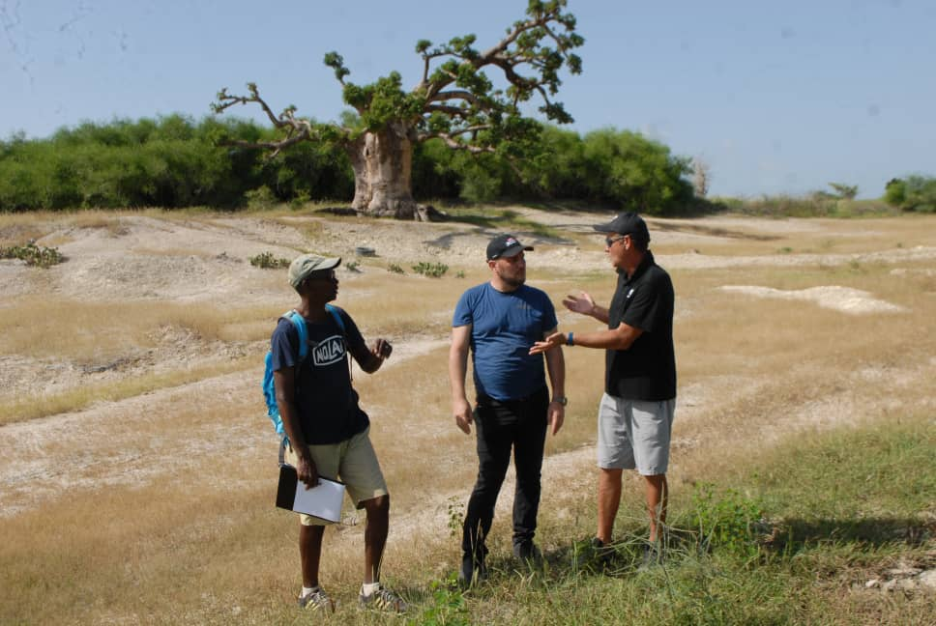
The facilities
A few hours were spent at their hard pack track where the trainer helped them with the design of their obstacles and updated them on the requirements with regards to track width, average speed, track safety and general FIM rules and specifications. It is a wonderful layout but lacks infrastructure such as start gates, clubhouse , jury room and basic amenities. The track surface is also laced with shale rock which isn’t ideal for traction or rider safety. After this the trainer spent time with their local riders setting up their suspension. Sunday was a race day with the juniors in the morning and seniors in the afternoon. The junior turnout was small but the racing was great. The clerk of the course was in full control and all rider safety protocols were on point. Their ambulances were extremely well equipped. Their makeshift track layout was fun. The senior track was absolutely brilliant, located on the beach right by where the iconic Dakar rally finish line was for so many years. Andre’s observations were that the trainers are both supportive and passionate and they understand the sport and what is required to succeed. This attitude alone will see athletes being moulded and the sport grow. On the Monday after the race, we did our debrief at the federations office in Dakar where Andre met a few dignitaries as the programme drew to a close.

Slide 9
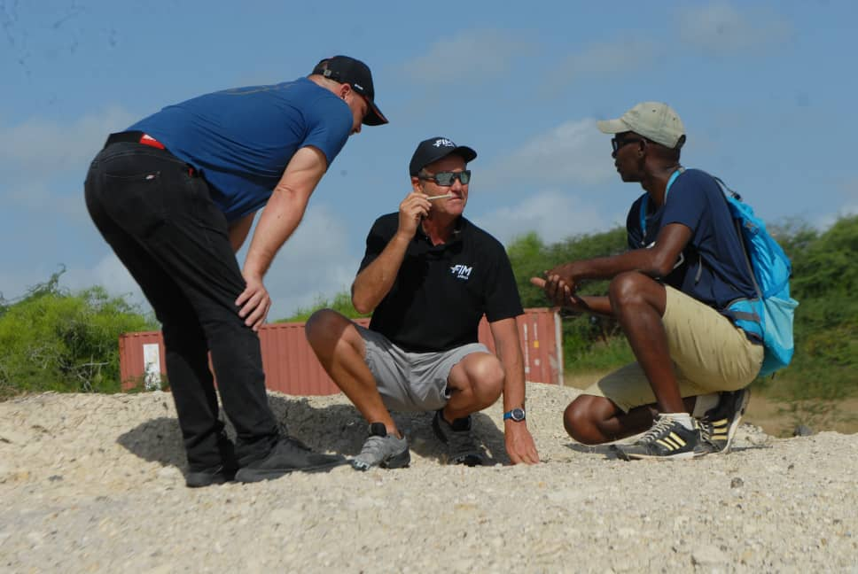
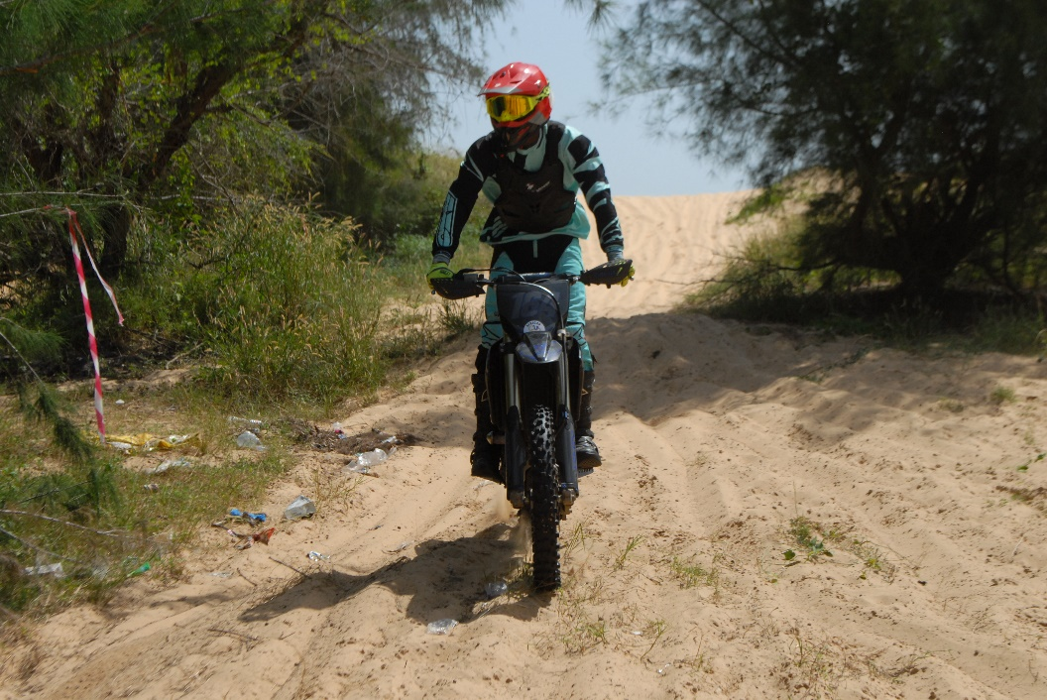
Future goals
The trainers and riders need a more permanent junior track facility where they can train consistently so as to progress the riders faster. This will also help the junior level to grow. The land for this facility has already been secured in preparation. A media group with the trainers was created to enable Andre to continue to communicate and provide the necessary support.

Slide 10
Summary
The Senegal racing fraternity is vibrant. In the words of the trainer: “I don’t believe that I have ever seen such passion for racing in a country. Their facilities and motorcycles both need upgrades but they certainly make the best of what they have. And at the centre of all this, is Daouda Ngom. His calm intellectual approach is steering Senegal forward. The trainers are so hungry for information. Their passion around their riders creates such a healthy environment.”
The next challenge, as for most of the countries, will be how the federation will be able to accredit the trainers, however, Andre will work with them to provide templates. This trip made a great impact on Senegal and their progression.
It is also worth noting that the President of the Cote D’Ivoire federation and his daughter also attended the training session thereby including an additional country into the programme.
Next stop will be to arrange for training in Mauritania in November 2025.
3. MX of Africa Nations - 2025
The last major event to report on is the MX of Africa Nations (MXoAN) which took place in Zimbabwe from 15th – 17th August 2025
The Motocross of African Nations (MXoAN) was held at Donnybrook Park, Harare, Zimbabwe, attracting 135 competitors from 8 countries:
Kenya
Zimbabwe
Namibia
South Africa
Madagascar
Zambia
Uganda
Botswana
A total of 15 female competitors took part, representing 11% of the overall entries. This illustrates progress but also highlights the significant gap in achieving gender balance in participation.

Slide 11
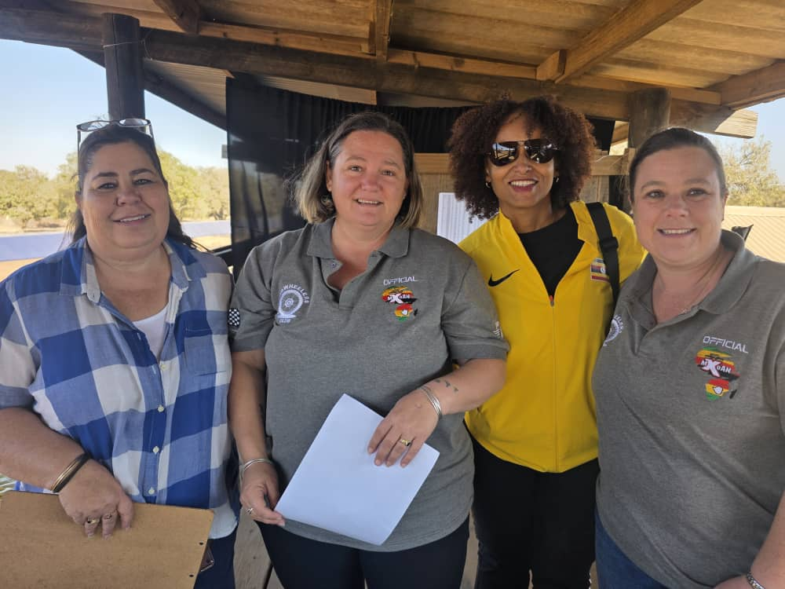
Female officials played key leadership roles in the event, including:
Jamie Kerwin (Event Secretary)
Lisa Upton (Jury Secretary)
Shelley Verwey (Assistant Event Secretary)
Jacquie (Botswana Team Manager)
Notable Results:
For the first time in 7 years we have a new WMX champion for this event:
1st Place : Caitlin Parks (Zambia)
2nd Place: Zoe Botha (South Africa)
3rd Place: Zoe Waldschmidt (Namibia)
Junior class winners:
Hellena Birungi (Uganda, 50cc)
Jamairah Makumbi (Uganda, 65cc)

Slide 12
Challenges Identified:
The 15:135 ratio (11%) of female riders emphasizes the need for FMNs to actively encourage and support more female participation at continental events. Incentives may be explored to improve turnout.
According to SSR 3.2, the Ladies Junior Challenge Cup was not eligible as a championship, despite its role in grassroots development. This caused disappointment among some parents who invested in their daughters’ participation.
Unfortunately, there have been various issues on the continent with the federations notably in Kenya, Botswana and Morocco which contributed to the reduced number of female participants in this event.
4. Ongoing & Future Initiatives
The WIM Commission is in the process of engaging with the CFM to host a series of online Women’s Empowerment Workshops aimed at equipping women with leadership, technical and competitive skills to further their involvement in the sport.
5. Overall
Zimbabwe demonstrated both growth and challenges in women’s participation during August 2025. The TTT program highlights the strong potential of local trainers to achieve accreditation while MXoAN showcased female talent on the continental stage but also exposed the continued gap in female rider representation. Moving forward, capacity building, federation-driven accreditation of trainers, and incentives for female participation remain key priorities.
B. Medical Commission
1. The commission has been focusing on two key aspects this year:
Continuing to build capacity through
Local first on scene medical training
Working with FMN’s to build local capacity for medics who will be available to sit the next FIM Africa medical seminar; date still to be confirmed.
Hosting the medical mentorship programme under FIM.
2. Working on developing the injury surveillance database with a pilot programme set to be rolled out in Kenya in the last quarter of 2025.

Slide 13
The Medical Commission successfully completed the 2nd Annual FIM Africa Medical Seminar 2025 on 3rd August 2025. It had a registration of over 50 medics from 6 countries. The attendees will be completing their exams and WADA accreditation before certification and This forms the background from which we will be drawing the participation for the December FIM Medical Mentorship Program
Landmark discussions in the plenary were centered on
Grassroots training of CMO/CMCs for Regions of Africa,
Sensitization of medics on the Medical Code and Anti-doping Code
The ongoing Digitalisation of Medical Examinations and Injury Surveillance Database for Africa. - We look forward to having it ready for launch and use by December and 2026 season.
The commission is also planning to host a 2 day mentorship programme to be conducted by Dr Roberts Furmanis (FIM) Medical Mentor in December 2025.
The programme will be held in Kenya alongside the MX CAC 2 .This activity will yield FIM CMI Licenses for those CMOs who are interested in taking the relevant exams:
We are pleased to inform you that the below FIM Seminar is now open for registration:
Commission : CMI (International Medical Commission)
Type of Seminar : CMI - Chief Medical Officer
Date(s) : 14.12.2025
Location : Kenya, Nairobi
Language : English
Please note that this seminar will close for sign up 3 days before its start on 11.12.2025
A copy of the proposed injury surveillance database template is attached for your review and comment as the medical commission prepares to finalise and roll this out.

Slide 14
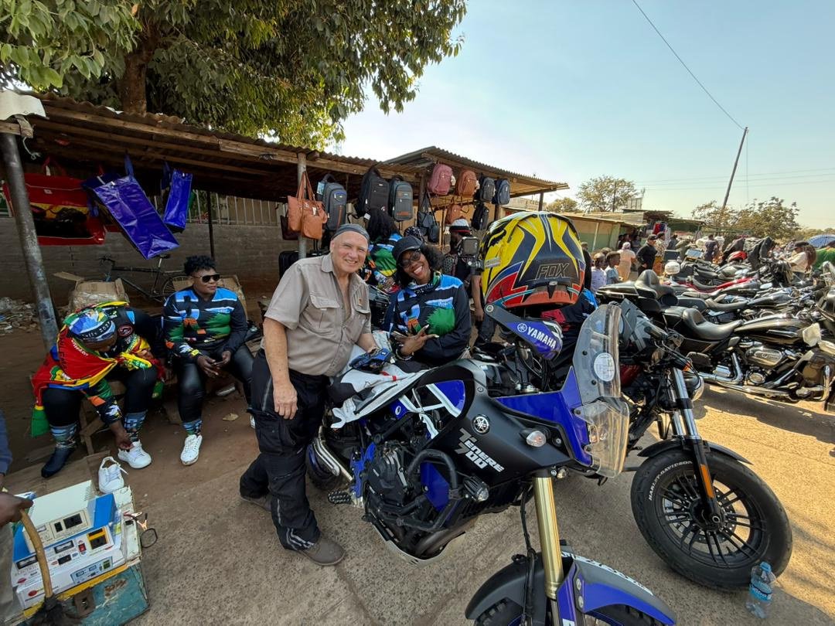
C. Leisure and Touring Commission
Rallies, Rides and Events
There have been quite a few activities happening under the auspices of the Leisure Touring Commission particularly in the Leisure Touring space.
Several large activities and events have been held with some having multi-national participation such as the following:
Earlier in the year key events included the Ubuntu ride in January, International Female Ride Day in early May and the Distinguished Gentleman’s Ride held in May. These are well attended events with good coverage and an amazing display of the camaraderie and unity amongst motorcyclists across all works of life.
Victoria Falls ladies tour from the to 6th to 10th August by a group of primarily South African female riders. Most of the group members had not travelled beyond Botswana before.

Slide 15

Other planned rides, rallies and tours in and around Central and Southern Africa:
26–29th September 2025. Victoria Falls to Lusaka. Mosi Oa Tunya Rally.
“The first official Sub-Saharan H.O.G. Rally is coming to life, and we’re hosting it in the KAZA region, one of the largest transfrontier conservation areas in the world.
Right next to Victoria Falls. That’s right, The Smoke That Thunders.
Or as we like to say, Africa’s original sound system.
This isn’t your average chrome-fest. This is the moment where wild landscapes meet wide handlebars, and 1,500 Harleys roll into the land of elephants, eagles, and eternal sunsets.
Because when Africa calls, you don’t whisper back. You thunder.

Slide 16
26–29th September 2025. Victoria Falls to Lusaka. Mosi Oa Tunya Rally.
Planned South Africa tour to Namibia from Nov 22nd to December 4th
Rumble in the Jungle Rider in Rwanda; Dates TBA
Several Bikers Prayer days in Uganda, Rwanda and Kenya in August.
One key area that remains a key concern for Leisure riders on the continent is the challenge of border crossings.
Although significant headway has been made by establishing a network amongst the riding community to communicate the processes for each country and provide assistance for transiting riders, it remains a major bottleneck.
The commission has been reviewing various options that would help to facilitate the border crossing process through the implementation of an integrated database of riders where riders are able to register and upload their details. This would be used by FIM – A leisure and touring representatives in each country to assist transiting riders with immigration and border crossing challenges.
Road Safety
There is one key issue that continues to mar the progress of leisure touring on the continent which is road safety.
Several of the events mentioned above have experience fatalities and only just this past week the medical commission lost one of its valued members to a motorcycle accident in Uganda.
The road safety agenda is one that the commission needs to take up with some more focus and aggression and with a unified approach that will have impact across all the FMN’s. This was a key topic of discussion at the just concluded BS chairman’s meeting with the medical commission agreeing to work together with the leisure touring to address this concern.
South African representative Maboku launched his 1UP passenger (pillions) safety campaign in in July aimed at primarily ladies who most time are the pillions with a call to wearing proper safety attire at all times (copy of pledge below).

Slide 17

Rider safety concerns remain a key priority with increased deaths reported especially in Uganda. There needs to be a clear continental strategy to address rider education as part of the 2025/26 agenda for the commission.
In Kenya, the Rising Stars Africa (RSA) programme aimed at educating and equipping Boda Boda riders in Kenya was successfully launched in Mombasa county in January 2025 with a record attendance of boda boda riders participating in the programme
co-presented by the National Police and National Transport Safety Authority (NTSA).
🏍️ RIDING 2UP? MAKE IT SAFE. MAKE IT COUNT.
Carrying a pillion passenger is more than just an extra seat, it's an extra responsibility. The Biker Safety Pledge is a commitment to ride smart, geared up, and within your limits.
✅ No riding under the influence
✅ Proper gear for you and your pillion
✅ Know your limits, follow the rules, ride responsibly
👉 Take the pledge and read the full safety checklist here: [Fima Website Link] #RideRightRideSafe #2UP #PillionSafety #BikersPledge #MSASafety #FIMAfrica #BikeLife

Slide 18
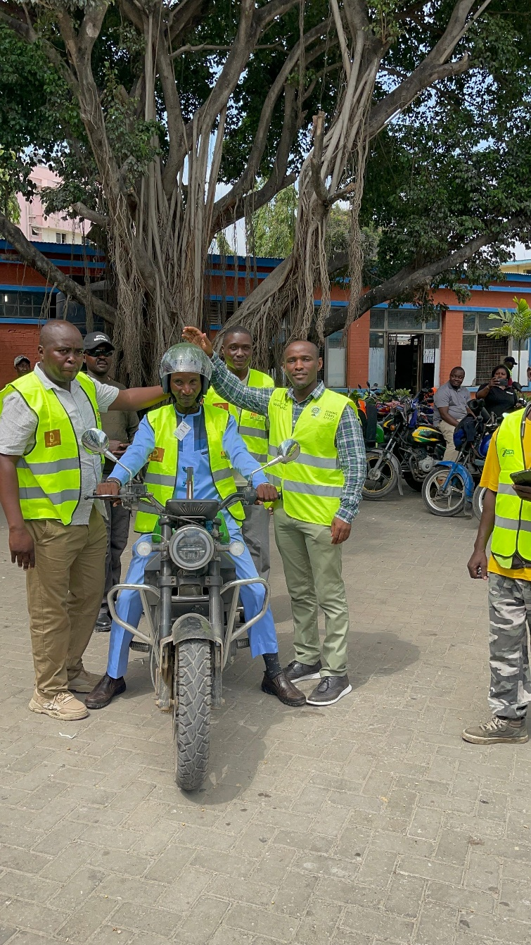
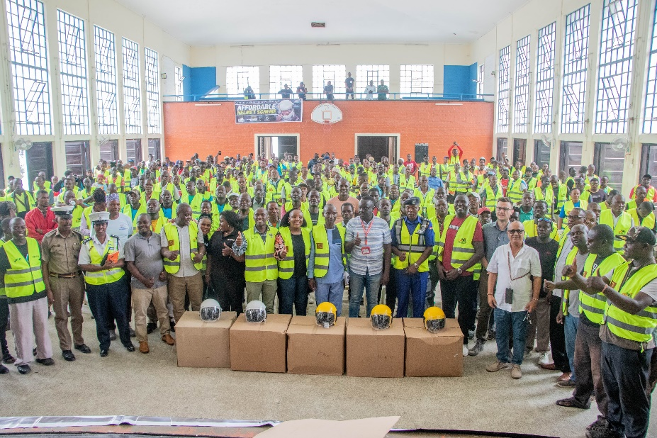
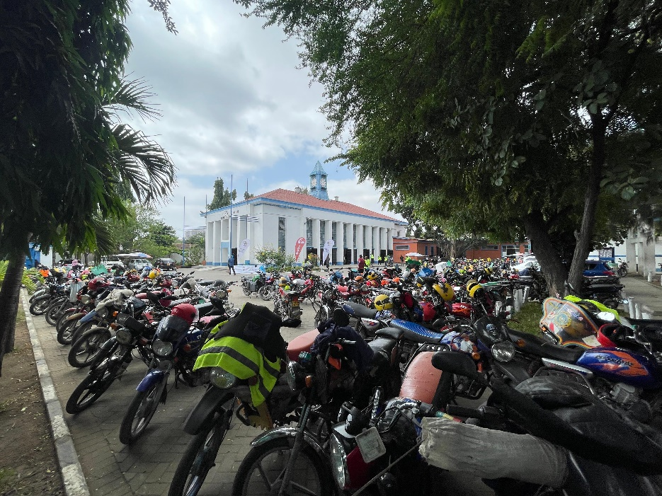

Slide 19
This October from the 25th to 28th, the road safety and empowerment project continued in Kiambu county at Thika Stadium. Please see below as sample of the closing day programme:
RISING STARS AFRICA BODA - ROAD SAFETY AND EMPOWERMENT PROJECT KIAMBU COUNTY - COHORT: 001 / 2025 PROGRAM OF ACTIVITIES FOR 25th, 27th & 28th OCTOBER 2025 AT C.I.T.C TECHNICAL AND BUSINESS COLLEGE, MAKONGENI - THIKA DAY 3
Tuesday: 0900 - 0930 Confirmation of Attendance RSA APP t SA, NPS,
0930 - 1030 Rotation 9 –Lower Limb Immobilisation and Patient Transportation
1030- 1130 Emerging trends in the boda boda sector
1130-1230 Group Empowerment with the Network BDN, RSA APP
1230 - 1330 Sponsor 1 time SPIRO AFRICA
1330 - 1400
LUNCH BREAK FOLLOWED BY GRADUATION CEREMONY
Sponsors : JUBILEE INSURANCE, KENYA COMMERCIAL BANK,SPIRO,WATU SACCO, CCBA Group, NTSA, National Police Service , KIAMBU COUNTY, BLADEDOC FOUNDATION, EMKF, SSK, POCUS CARE AFRICA
This nationwide initiative will see RSA conducting similar programmes in all 47 counties of Kenya over the course of the next few years with the aiming of curbing boda boda related injuries and deaths
FIM/FIM- A Supported Events
Much of the recent discussion has been around establishing a FIM Africa Rally aimed at promoting leisure touring and Safety across Africa with the first destination being Tshwane as the host city.
Event Proposal:
The FIM Africa Rally & Carnival – Church Square is a four‑day, city‑centre destination event designed to revitalise Pretoria CBD, showcase Tshwane’s heritage, and grow safe leisure motorcycling across Africa under FIM Touring (CTL) codes. The event blends:
Touring & safety workshops,
Parade and show runs (city loop),
Vendor village & manufacturer expo along the Church Square street‑walk (Helen Joseph St) between Thabo Sehume (Andries) and Bosman,
Music & cultural programming, and
Guided tourism experiences (Union Buildings, heritage museums, inner‑city walking tours, Cullinan and Dinokeng).

Slide 20
Target participation: ~5,000 riders (peak‑day footfall 8k–10k incl. public), with scalable infrastructure for future editions.
Outcomes:
Reposition Pretoria inner‑city as a safe, vibrant events district;
Visitor nights & local spend for CBD hotels, restaurants, traders;
SMME inclusion (food, crafts, moto services, touring companies);
City‑wide messaging on road‑safety & protective gear;
Establish Tshwane as the African launch host for an annual FIM‑recognised touring gathering.
Two additional ideas that have been mooted to promote Leisure Touring under the FIM Africa banner are as follows:
FIM Africa Tourism Passport Challenge (See details attached)
The aim would be to encourage riders to visit key sites across various African countries with examples such as:
Heritage Sites
Mosi‑oa‑Tunya / Victoria Falls (World Heritage Site shared with Zimbabwe)
Kalambo Falls Archaeological Site (prehistoric settlement) UNESCO World Heritage Centre Chirundu Fossil Forest UNESCO World Heritage Centre
Mwela Rock Paintings
National Parks
South Luangwa National Park
Kafue National Park
Lower Zambezi National Park
Mosi‑o‑Tunya National Park (home to Victoria Falls) Kasanka National Park North Luangwa National Park Lochinvar National Park Liuwa Plain National Park Nsumbu National Park Sioma‑Ngwezi National Park

Slide 21
Waterfalls
Victoria Falls (Mosi‑oa‑Tunya) UNESCO World Heritage Centre
Kalambo Falls UNESCO World Heritage Centre
Kundalila Falls
Lumangwe Falls
Ngonye Falls (Sioma Falls)
Chishimba (Chisimba) Falls
Mumbuluma Falls
Launch of the FIM Advantage Card with emergency support and discounts. The implementation of the card would be an avenue to generate funding for the commission and also a platform to develop a membership portal and benefit system.
Along with the Rally, the passport and the Advantage card launch would be active social media campaigns tagged to FIM Africa to boost conversation, engagement and awareness of FIM Africa amongst the riding community in Africa and beyond.
This first Rally would be used as a foundation for growing FIM leisure and touring in Africa followed by a gradual rollout of digital tours and activities, accompanied by road safety campaigns and part of a multi-year plan.
There are significant budget implications and requirements for this initiative. We are planning several meetings in the month ahead to discuss these and consider also putting in a funding proposal for FIM for the 2026 calendar year.
Commission Participation
In July, Nigeria nominated Nengimote Hanson to join the commission.

Slide 22
D. Sustainability Commission
Several environmental training sessions were conducted by MSA over the months of May and June, which were also open to other FMNs on the CONU to attend.
The next step will be to follow-up with each FMN to review their environmental code to align with that of FIM-Africa/FIM and ensure they license their national officials before seeking to have FIM-A licenses issued.
Commission Restructuring
The other urgent item will be to reconstitute and activate the sustainability commission with the support of the FMNs and consider finally appointing Ross Branch as the African Ambassador.
This however needs to be done with a specific plan and objectives to be achieved for the commission and for the Ambassador.
This will be my main area of focus for 2026.
Julie Matiba-Wahome
Beyond Sports Director – FIM Africa
October, 2025

