Slide 1

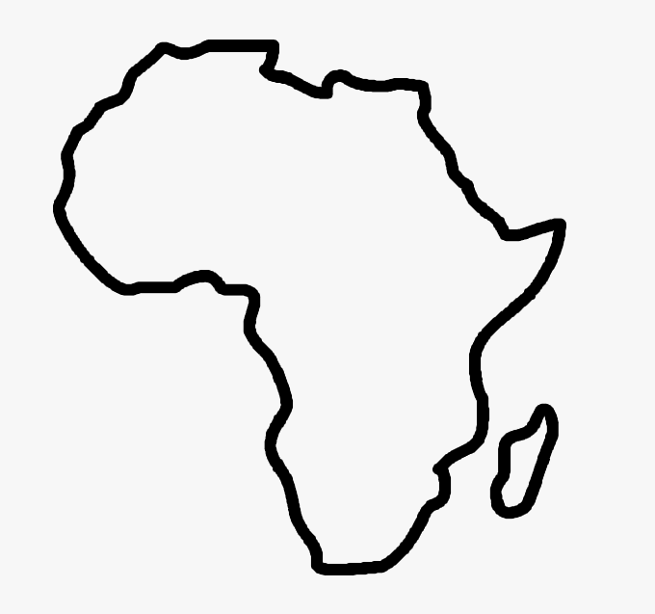

VICE PRESIDENT REPORT
North & West Africa
8 November 2025
FIM Africa General Assembly
Mombasa, Kenya

Slide 2


Egypt
Weaknesses: Dual federations, poor media, lack of circuits.
Potential: Cross Egypt Challenge, Jordan cooperation, strong federal figures.
Development: Tourism and gathering focused federation relaunch.
Expectations: Training, transnational networking, communication support.
major sporting event

Slide 3

Libya
Weaknesses: Security risks, zero infrastructure, doubtful rally feasibility.
Potential: Natural terrain, local passion, 2025 calendar ambitions.
Development: Occasional informal events, no guarantee of continuity.
Expectations: Training abroad, conditional support, technical buildup.
major sporting event

Slide 4

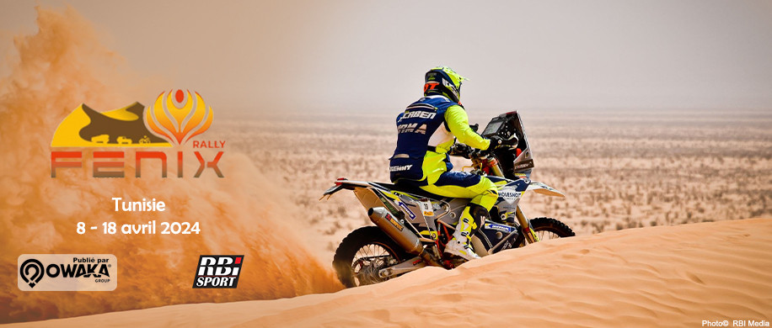
Tunisia
Weaknesses: Governance vacuum, ageing/controversial candidates.
Potential: Regional events, motocross training, legal reform hope.
Development: Fragmented efforts, club-level survival.
Expectations: Guide institutional transition, club support, ensure safety.
major sporting event

Slide 5


Algeria
Weaknesses: Disconnected federation, inactive digital presence, recent FIM suspension.
Potential: Favorable terrain for rally and enduro, revival of international events. New affiliation in progress
Development: No official calendar, informal activity.
Expectations: Re-engagement through focal points, request federation updates.
major sporting event

Slide 6


Morocco
Weaknesses: Internal federation crisis, leadership contestation.
Potential: Continental rally leader, robust tourism sector, Sand race event in Tanger for 2026.
Development: Technical strength intact despite internal issues.
Expectations: Neutral support, maintain technical collaboration.
major sporting event

Slide 7


Mauritania
Weaknesses: Absent federation, outdated contacts.
Potential: Sahara legacy, potential youth engagement.
Development: No visible activities.
Expectations: Audit the situation, consider rebuilding.
major sporting event

Slide 8


Senegal
Weaknesses: Lack of funding, reliance on private actors, dormant training programs.
Potential: Saly circuit, youth academy, popular engagement.
Development: Vibrant informal activity with high participation.
Expectations: Launch training, create circuit structure, advocate for recognition.
major sporting event

Slide 9


Côte d’Ivoire
Weaknesses: Political instability, event cancellations, federative frustrations.
Potential: Urban vibrancy, motocross project, 110cc accessibility.
Development: Regional momentum despite weak national coordination.
Expectations: Support motocross project, enable regional circuits, manage SSV dynamics.
major sporting event

Slide 10
Summary: Motorcycling in North and West Africa
Motorcycling across North and West Africa shows that the sport started to be more structured, with major international events like presented, backed by institutional and tourism support.
Common strengths include vast geographic potential for rallies and adventure tourism, a young and passionate population, and federations increasingly aligned with FIM Africa. However, the region faces major weaknesses—limited infrastructure, safety issues, and uneven regulation—hindering the sport’s growth and visibility.
Development opportunities lie in promoting motorcycle tourism, improving safety and training, and enhancing regional cooperation.
FIM Africa is expected to strengthen local federations, harmonize regulations, and foster youth and women’s participation. Turning everyday motorcycle use into a true sport and tourism culture will define the sector’s long-term success.

